Slide 1
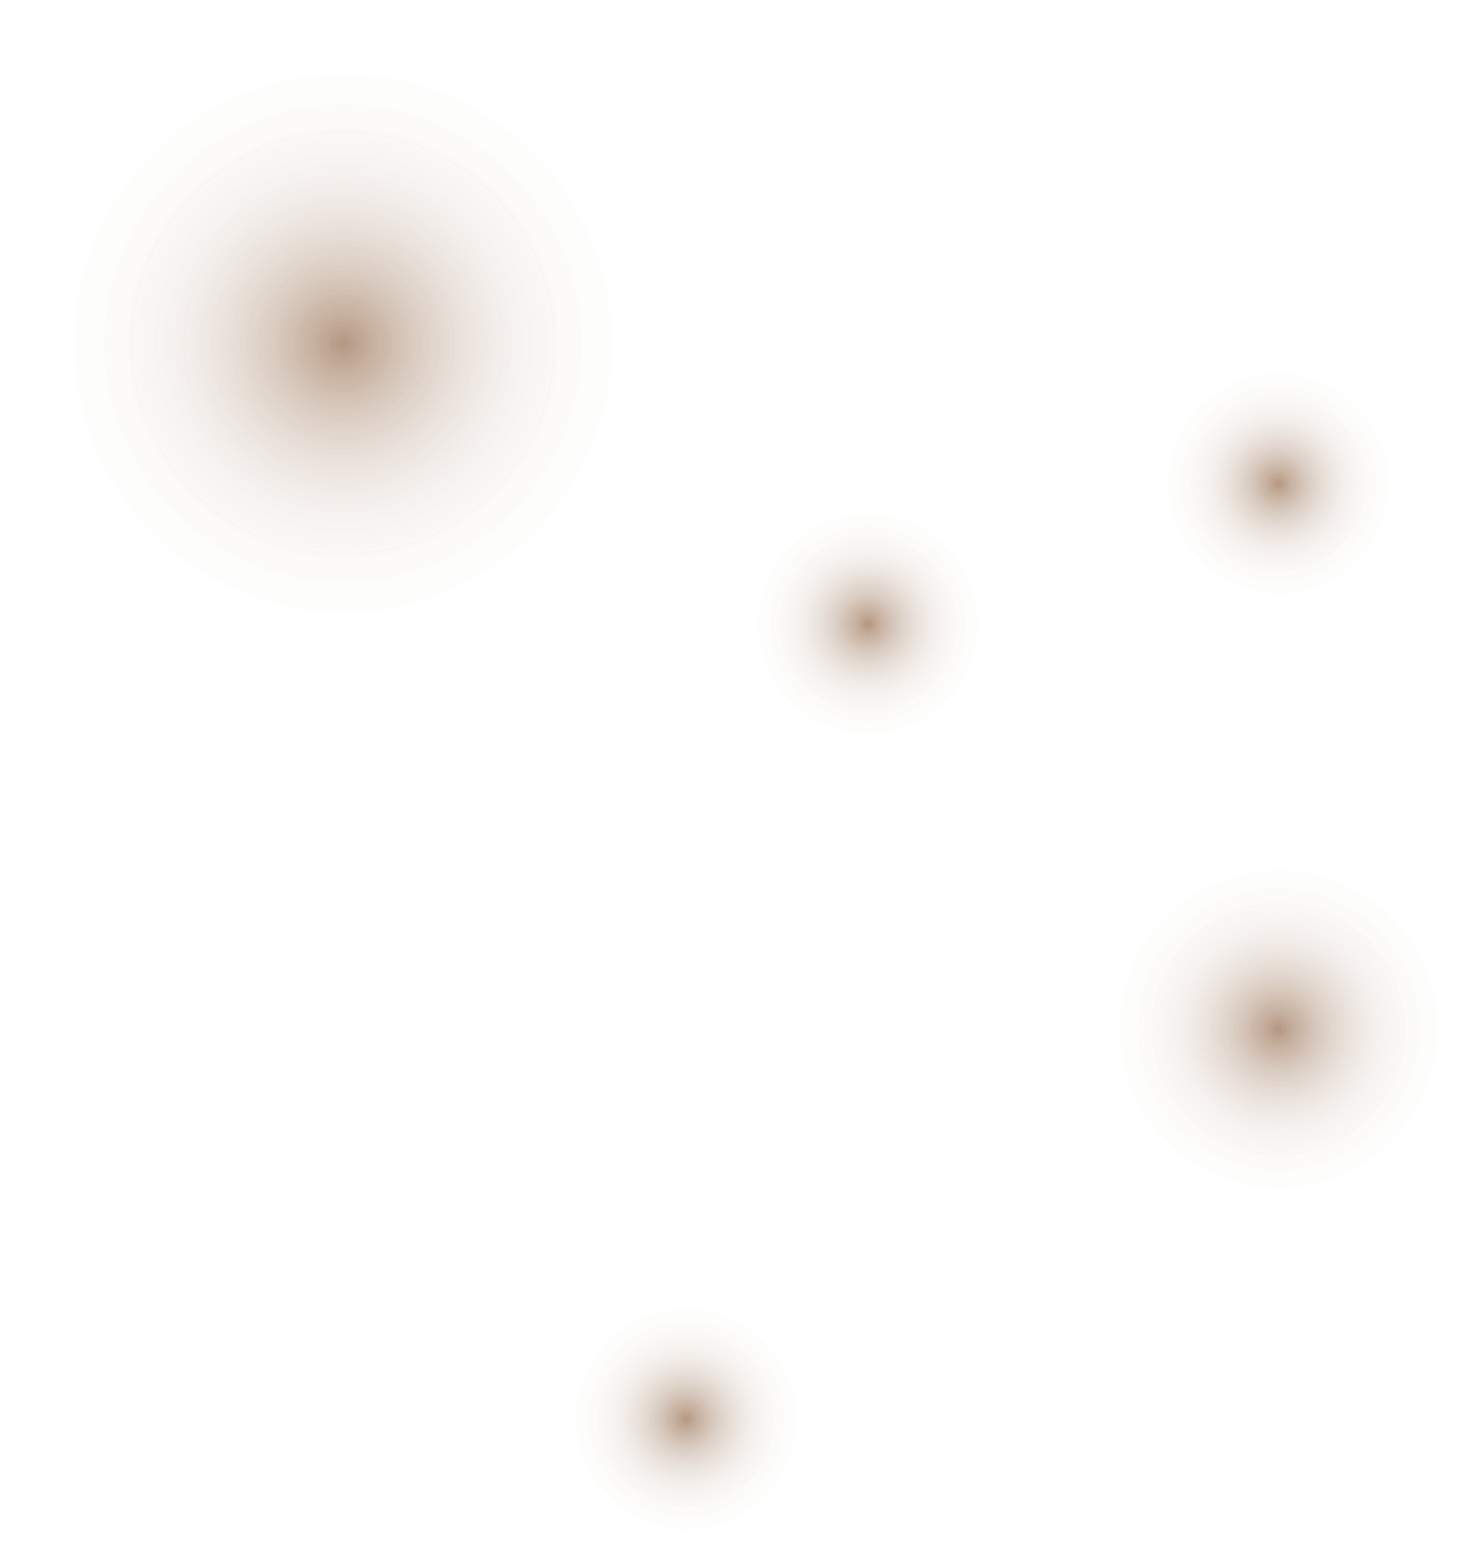
Exploring Methods for Computing Absorbed Radiation Dose in CT Imaging
Group 4 - Avanti Bhandarkar, Diana Vucevic, Sharvari Deshmukh
Notes:
Good morning, we are group 4 and we will be presenting some methods for computing absorbed radiation dose in CT imaging

Slide 2

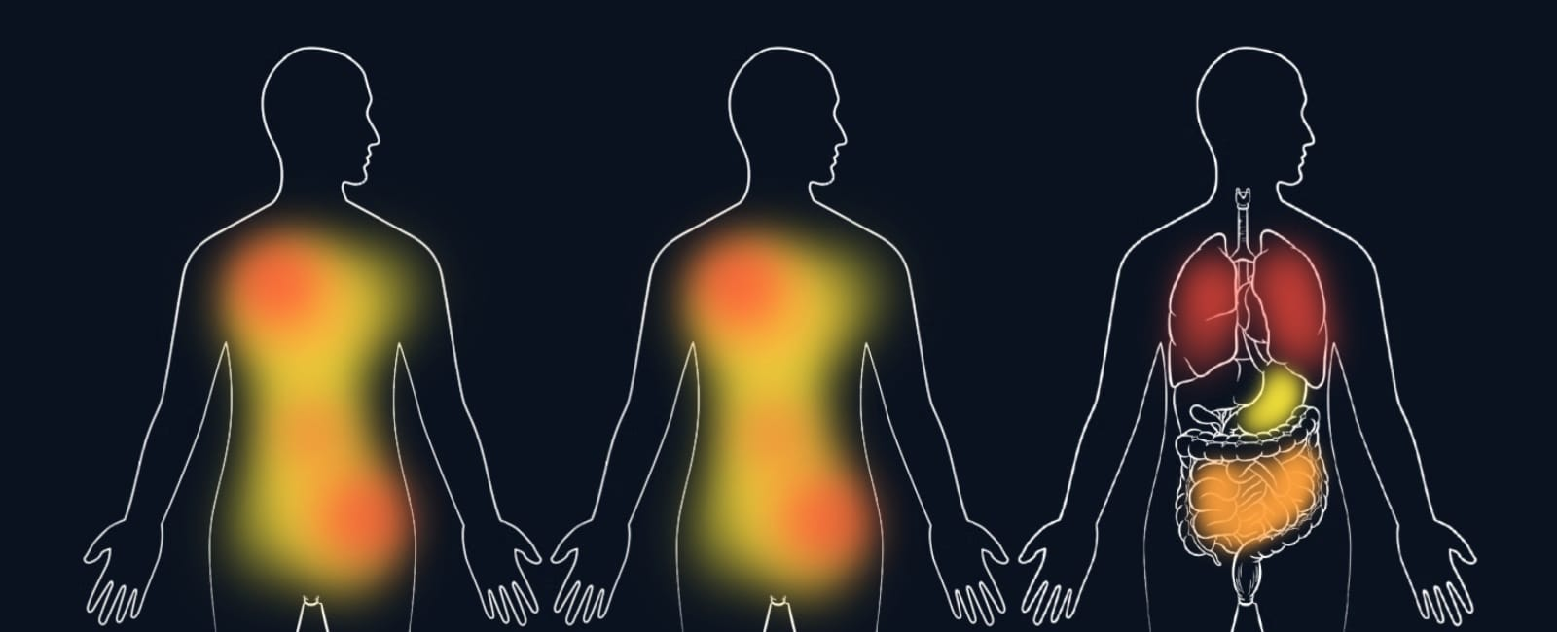
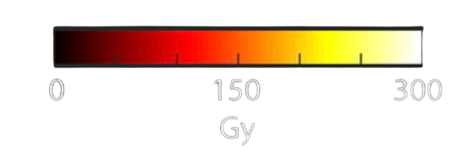


Types of Radiation Doses
Absorbed dose (Gray/Gy) →
Equivalent dose (Sievert/Sv) →
Effective dose (Sievert/Sv)
Notes:
There are 3 types of radiation doses:
Absorbed dose is a fundamental measure of radiation exposure, and represents the amount of energy deposited in a specific volume of tissue.
Equivalent dose builds on absorbed dose by incorporating a radiation weighting factor (Wr), which accounts for the biological impact of different types of radiation.
Effective dose goes a step further by accounting for the different sensitivities of tissues and organs to radiation. It is especially useful in assessing long-term health risks, as some tissues are more prone to radiation damage than others.

Slide 3
Why Does Dose Estimation Matter?
Effects of radiation exposure
Deterministic effects - usually occur only at high doses → skin burns, hair loss, ARS
Stochastic effects - can occur at any dose → cancer and genetic mutations
For e.g., while performing dose estimation in pregnant women [1,2]
Fetal CT radiation increases (up to doubles [3]) the risk of childhood cancers
May also lead to congenital malformations and growth restriction in extreme cases
Keep the radiation dose ALARA
Notes:
Dose estimation is a crucial preliminary step to preventing unnecessary radiation exposure. Radiation exposure usually has 1 of 2 effects:
Deterministic effects increase in severity with higher doses of radiation and typically have a threshold below which they do not occur.
Stochastic effects are random and can occur at any dose, with the probability of occurrence increasing with higher doses. They do not have a defined threshold of occurrence
If we consider the case dose of estimation in vulnerable populations like pregnant women
It is crucial to keep radiation exposure low to lower the risk of childhood cancers, developmental issues and malformations of the fetus
The aim is always to keep radiation ALARA → As Low As Reasonably Achievable

Slide 4
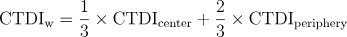
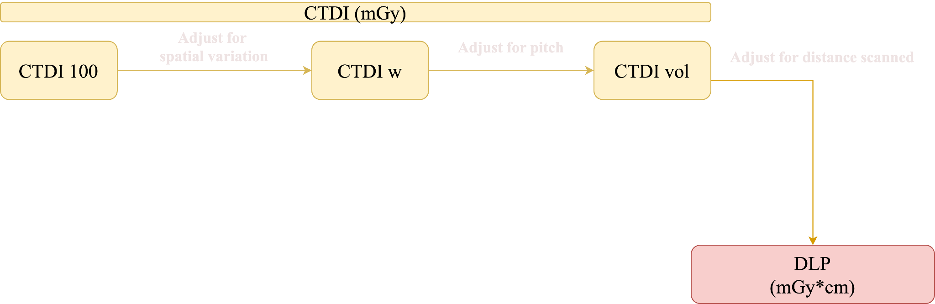

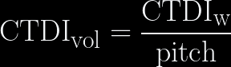
Clinical Dose Metrics
Notes:
Let us take a look at the dose metrics that are commonly used in clinical settings
The CT Dose Index or CTDI provides a standardized measure of the radiation dose from a single CT slice or rotation.
We start with CTDI 100 which determines the dose at the center of a CT slice for a single rotation.
If we adjust CTDI 100 dose levels to account for the fact that dose levels are typically higher at the periphery of the scan area than at the center, we get the CTDIw value.
Finally, considering the distance between each slice and adjusting for variations in pitch gives us CTDIvol which provides a more accurate dose measurement for continuous, overlapping scans
The product of CTDI volume and the entire scan length gives us a new metric called the dose length product or dlp which measures the total radiation dose delivered across the entire scanned area

Slide 5
Limitations of Clinical Dose Metrics | How Can Monte Carlo Simulations Help?
Lack of Personalization Across Patients | Patient-Specific Modeling
Oversimplification of Dose Distribution | Enhanced Dose Distribution Tracking
Limited Relevance for Risk Prediction | Ability to Generate a Cumulative Dose Profile
Cannot Incorporate Motion / Scanning Parameters | Better Handling of Complex Scanning Parameters
Notes:
Although they have been widely adopted clinical dose metrics have some limitations, which probabilistic simulations like monte carlo simulations can help overcome.
CTDI and DLP are standardized metrics based on average patient models which means that doses may be incorrectly estimated for patients whose body types differ from the norm.
Monte Carlo simulations on the other hand, can utilize unique anatomical and tissue variations across patients, which allows for patient specific modeling
CTDI and DLP offer a limited view of dose distribution within the body, since they fail to capture variations across individual tissues and organs.
Monte Carlo Simulations generate a probability distribution of dose values for tissue categories and also map radiation distribution throughout the scanned region, not just at the surface. Both these features result in a better distribution profile.
CTDI and DLP have limited ability to predict patient-specific risk, since they do not account for the varying sensitivities of patients to radiation or cumulative exposure over time.
Monte Carlo Simulations can be repeated over time and combined to provide a cumulative dose profile, which gives a good estimate of evolving patient-specific risk.
Finally, CTDI and DLP measurements do not reflect potential dose variations caused by patient motion, and may underestimate or overestimate the true dose for helical and multi-slice scans.
Monte Carlo simulations provide a more realistic estimation of dose exposure across multiple scanning planes and paths

Slide 6



How are Monte Carlo Simulations
Used for Dose Estimation?
Generate photon energies using the cumulative distribution function (CDF) of X-ray energies
Photon Generation
Photon Transport
Calculate attenuation as photons pass through different tissues, using
Energy transferred to tissue per unit mass, calculated using
Energy Deposition
Notes:
Next, we move on to photon transport. Here, we're looking at how these photons move through the body and interact with tissues. The attenuation model, I=I0e−μxI=I0​e−μx, describes how the intensity of the photon beam decreases as it passes through tissues. The μμ represents the attenuation coefficient, which varies based on the type of tissue—like bone, muscle, or fat—and the energy of the photon.

Slide 7
Key Scanner Parameters and Their Relation to Dose ^{[4]}
Parameters | Relation to Dose
Pitch | Inversely proportional
Rotation Time | Directly proportional
X-ray Tube voltage (kVp) | Directly proportional
Source to image distance (SID) | Indirectly influences by affecting the uniformity and intensity of X-rays across the scanned region
Notes:
Pitch: how fast the table moves through the CT scanner relative to the width of the x-ray beam.
P <1: Higher dose, better image resolution
P > 1: Lower dose, but potential for decreased image quality
Rotation time: time taken for x-ray tube and detectors to complete one full rotation around the patient
For fixed tube current, if rotation time is increased, dose increases
Shorter rotation time, dose is reduced
X-ray Tube voltage (kVp)
Controls the energy of the X-ray photon. Higher tube voltage increases photon energy, which impacts attenuation characteristics and dose distribution
Source to image distance (SID): The distance between the X-ray tube and the detector

Slide 8
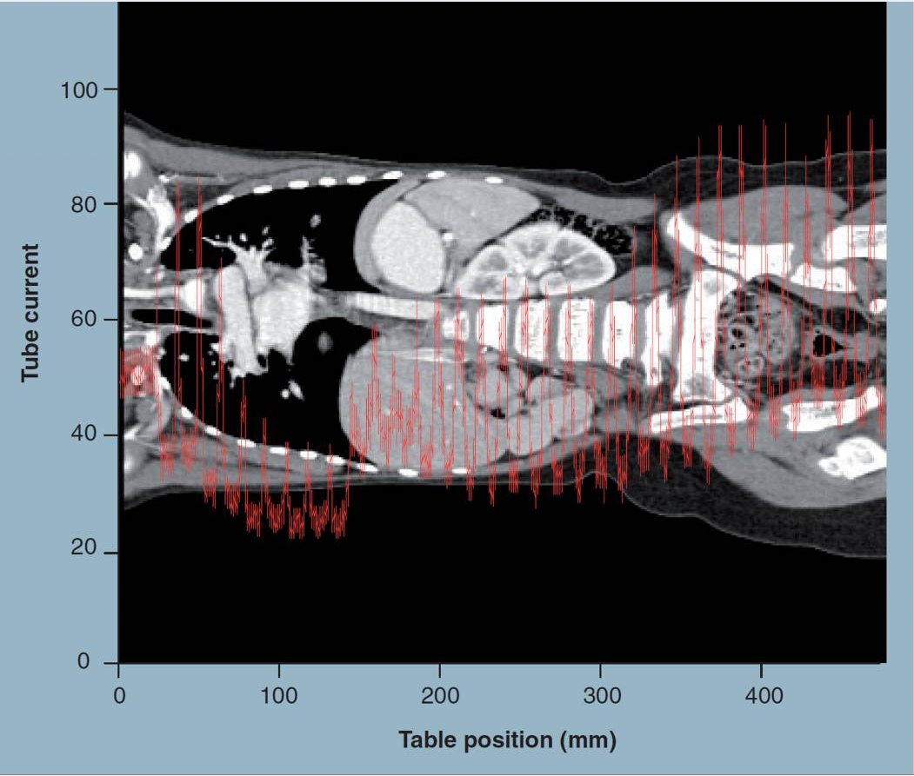
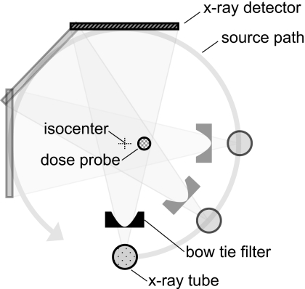
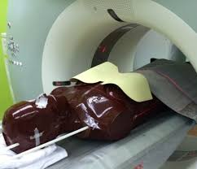
Dose Modulation/Reduction in CT Scans
Tube Current Modulation (TCM) Physical filters
Figure 2. Bismuth Shielding
Figure 3. Bow-tie Filters
Figure 1. TCM
Notes:
Tube Current Modulation (TCM)
Adjusts the X-ray tube current based on the patient’s anatomy to balance image quality and dose
Physical filters
Specifically shaped filters that are used to shape the x-ray beam → reduce the intensity of X-rays at the periphery of the patient
Bowtie filter
Bismuth shielding

Slide 9
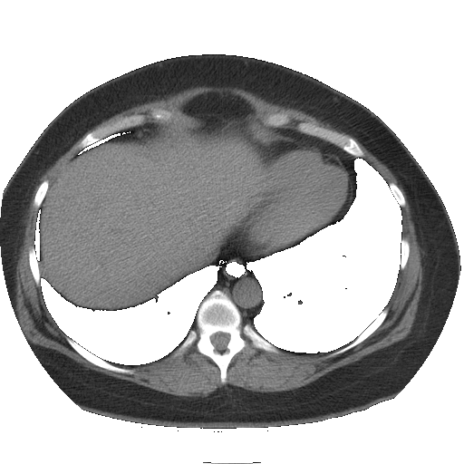
Dataset ^{[5,6]} for Our MC Simulations
Scanner (SOMATOM Definition AS 64) characteristics
SID, Tube V, Bowtie specific source model (CDF)
Patient information
DICOM files, gestational age, D_{w, topo}, D_{w, image}
Exam specifications
Rotation time, pitch, max/mean/effective tube current, CTDI_{vol}, nominal beam collimation, etc.
Fetal dose simulation and estimates
No. of photons, MC output, absolute organ dose, Normalised output and organ dose
Sample CT scan of Patient
Notes:
So based on this knowledge, we tried to code a very basic monte carlo simulation. The dataset we used is of 24 pregnant women with different gestation periods ranging from 5-36 weeks. The dataset had all these details like scanner properties, patient information, exam specifications and their MC simulation parameters. For our simulations we assumed the same helical CT scanner with 0.5 s rotation time and pitch of 1 with ~19 mm nominal beam collimation.

Slide 10
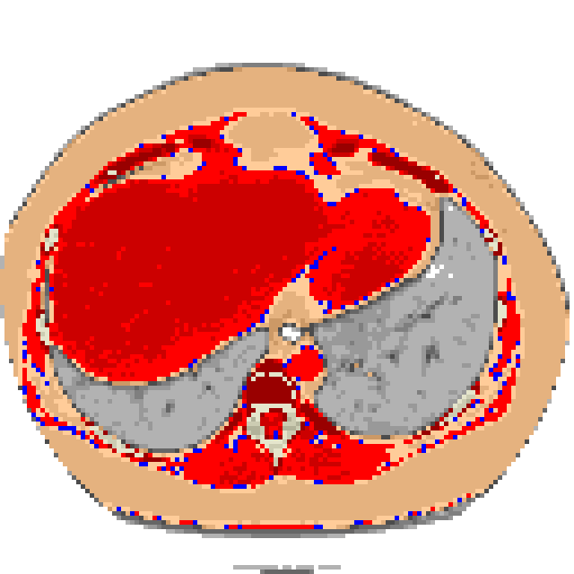
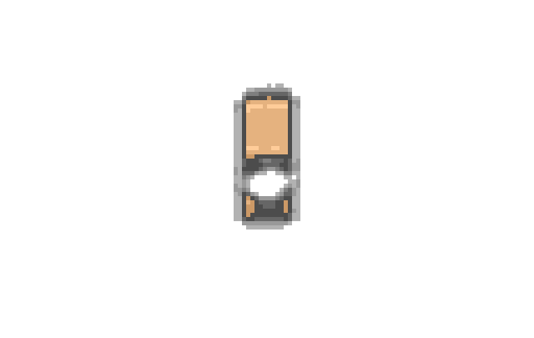
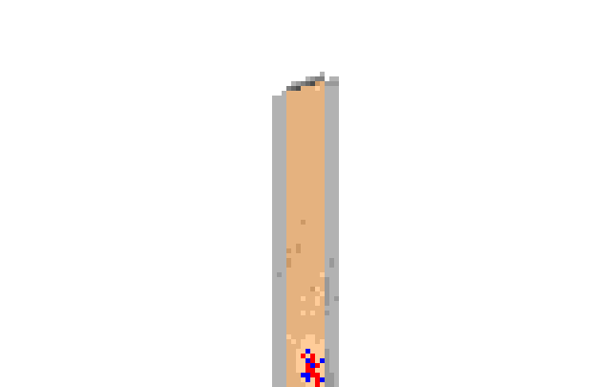
Anatomy-Aware Voxelized Models
Tissue categories: darker = denser
Gray - Lung tissue
Brown - Fat / soft tissue
Red - Muscle
Off-white and Gray - Bone
Pregnancy-specific tissues
Off white - Fetal bone
Lavender - Fetal tissue
Green - Gestational sac
Pink - Uterus
Non-anatomical materials
Blue - Water
White - Air
Coronal view
Axial view
Sagittal view
Notes:
The dataset also has the tissue densities mapped to corresponding voxels. We have created visualization here based on the values and color coded for different kind of tissues. You can see the segmented voxelized models in three different views here.

Slide 11
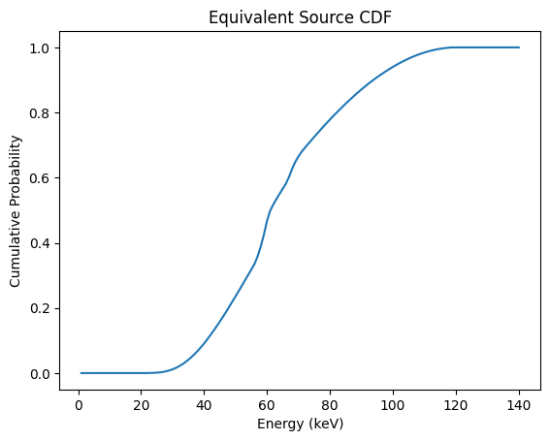
MC Simulations: Methodology
Voxelized Anatomical Models using DICOM and MCNPX input files
Mapped tissue code to densities for tissue segmentation
Downsampled slice image to 1 / 4th to decrease computation time
TCM vs FTC for CDF of photon energies from source
Notes:
To give a brief about our simulation, MC simulations are inherently very complex and computationally intensive. Given the scope and limitations of this project, we used a number of approximations and assumptions. The goal was to understand how each CT parameter affects the dosage but reduce the overall complexity of the computation. For example, Out of all patient data, we used a specific fetus and a specific slice to estimate the dosage. We downsampled the slice from 512x512 to 128x128. The dataset already provided the cumulative distribution for the photon energies which we used for our simulations. We simulated the FTC i.e fixed tube current scenario. This is the CDF for 120 kV tube Voltage.

Slide 12
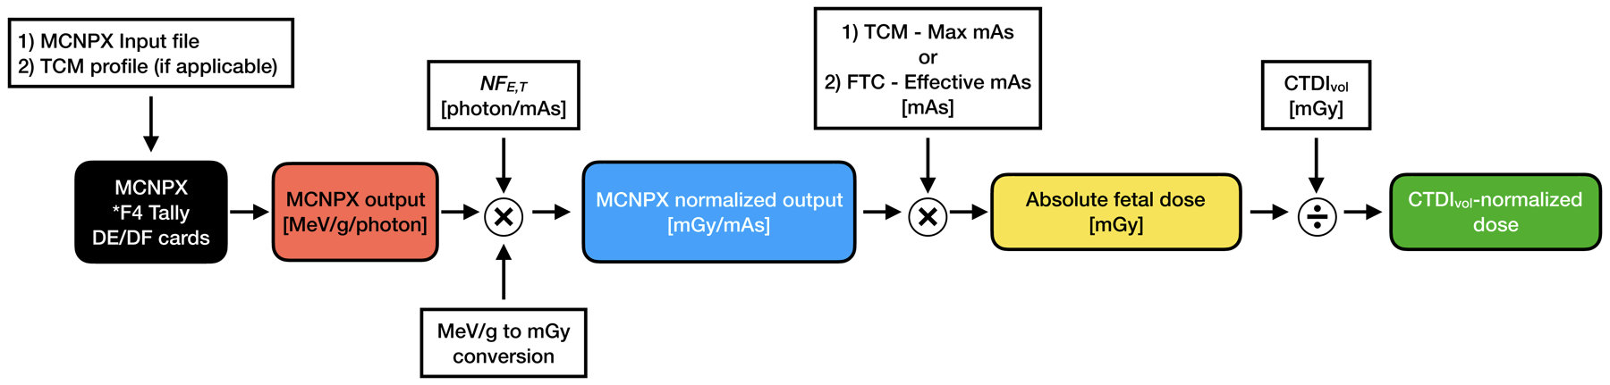
MC Simulations: Methodology
Number of photons : 100 per 10⁰ angle per voxel
Used image position, orientation and SID to calculate distance between source and voxel
Attenuation constant approximation
Energy to dosage conversion
Figure 4. Process of obtaining absolute and normalised fetal dose
Notes:
We simulated for 100 photons per 10 degree angle per voxel that came upto around 58 million photons per slice. Out of these 100 photons, we attenuated the number based on distance between source and voxel scaled by water equivalent diameter of the slice. We calculated the distance between source and voxel based on image pos, orient & SID. Out of the remaining photons, we calculated the probability of interaction of the photon with the voxel tissue based on the energy of the photon and linear attenuation coefficient of the tissue, scaled by a factor of 3 to compensate for our approximations. We also incorporated the inverse square law, to determine this probability. Once we got the number of photons interacting with each voxel based on this, we used the energy to dosage conversion process from the reference paper to get absolute dose for the slice.

Slide 13
MC Simulations:
Limitations & Approximations
Constraints: Complexity, Time, Computational Resources
Approximations:
Simplified Anatomical Model
Energy Cutoff and Local Deposition
Scanner Geometry and Parameters
Simulation parameters
Photon & Tissue interactions
Uncertainty factor
Notes:
To reiterate, we understand that this doesn’t fully represent all the photon-tissue interactions. Ideally the Mc simulations are run using complex software like MCNPX i.e Monte Carlo N-Particle Transport Code created at Los Almos Lab. We are aware of the limitations and hence haven't simulated all of the involved physical effects like photo-electric, compton scattering and other uncertainties. To make further simplifications, we have assumed factors like single rotation of scanner per slice, simulated photon affecting just one slice at a time. We haven’t factored in other parameters like fan angle or complex geometry arising from a helical CT path either.

Slide 14
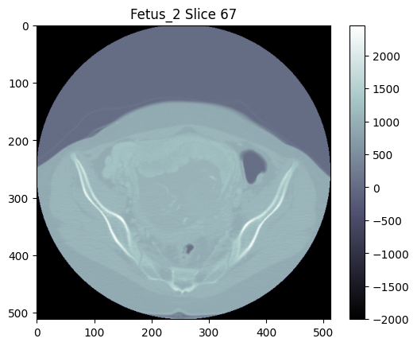
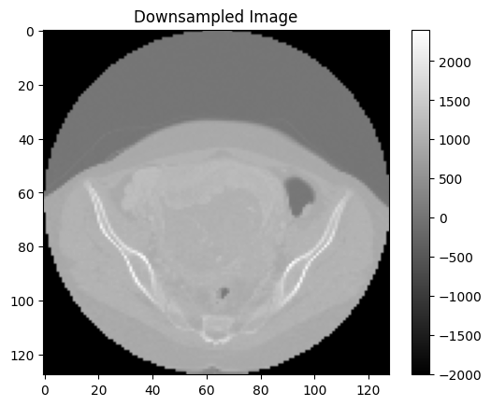
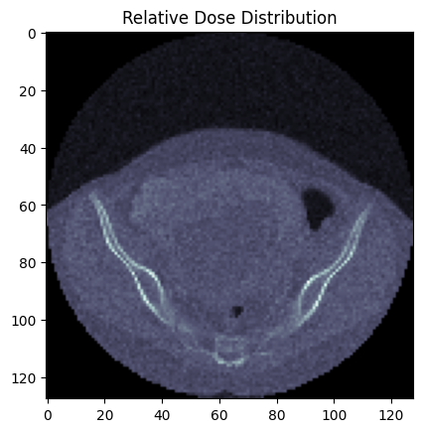
MC Simulations: Results
Absolute dose for slice: 7.4 mGy
CTDI_{vol} Normalized dose for slice: 0.47
Notes:
This is how the results from our simulations look like. The simulation output is close to the MC output of the reference paper. Using the normalization factors for the same paper, we are able to plot this heatmap of dosage distribution for a slice. The values of the dosage are close but not accurate as per our benchmark, as is expected because of our approximations and simplifications.

Slide 15
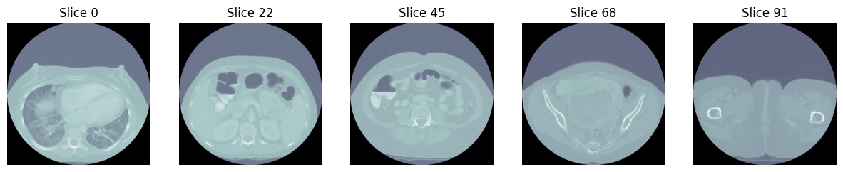
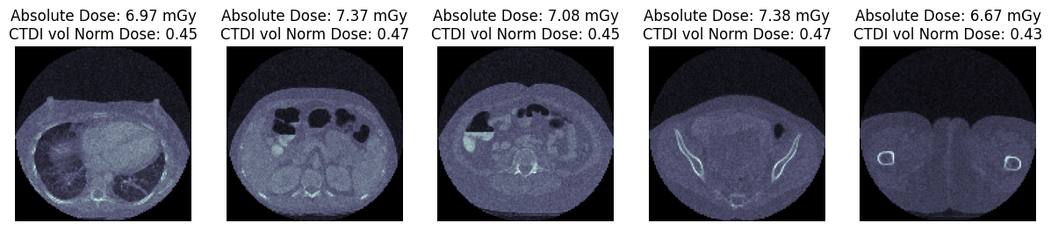
MC Simulations: Results
Notes:
And these are some estimated dosages for some other slices of the same fetus CT scan. The doses are closer to the benchmark but more importantly, we can see the relative dose distribution even from the approximated simulations.

Slide 16
References
Papers
[1] Sadro, Claudia T., and Theodore J. Dubinsky. "CT in pregnancy: risks and benefits." Applied radiology 42.10 (2013): 6.
[2] Chen, Morie M., et al. "Guidelines for computed tomography and magnetic resonance imaging use during pregnancy and lactation." Obstetrics & Gynecology 112.2 Part 1 (2008): 333-340.
[3] Goldberg-Stein, Shlomit, et al. "Body CT during pregnancy: utilization trends, examination indications, and fetal radiation doses." American Journal of Roentgenology 196.1 (2011): 146-151.
[4] Goo, Hyun Woo. “CT radiation dose optimization and estimation: an update for radiologists.” Korean journal of radiology vol. 13,1 (2012): 1-11. doi:10.3348/kjr.2012.13.1.1
[5] Hardy, Anthony J., et al. "Reference dataset for benchmarking fetal doses derived from Monte Carlo simulations of CT exams." Medical physics 48.1 (2021): 523-532.
[6] Angel, Erin, et al. "Radiation dose to the fetus for pregnant patients undergoing multidetector CT imaging: Monte Carlo simulations estimating fetal dose for a range of gestational age and patient size." Radiology 249.1 (2008): 220-227.

Slide 17
References and Resources
Websites
CT Dose: https://radiopaedia.org/articles/ct-dose?lang=us
Radiation Dose Reporting: https://health.ucdavis.edu/radiology/radiationdose.html
Dataset
Reference Dataset for Benchmarking Organ Doses Derived from Monte Carlo Simulations of CT Exams
Accessed from https://zenodo.org/records/3959512 on October 18, 2024
Our Code
https://github.com/186shades/ct-dose-estimation

Slide 18
Thank You!

